Slide 1
English for Communication Skills

Slide 2

Letter Writing
Clear
Concise
Correct
Courteous
Conversational
Convincing
Complete

Slide 3
Standard Elements of a Business Letter
Letterhead
Date line
Inside address
Salutation
Body of letter - message
Complementary close
Signature block

Slide 4
Letterhead - examples

Slide 8
Letterhead
Logo
Name of the organization
Postal address
Telephone numbers
Email addresses
Website address

Slide 9
What’s the name of the sender?

Slide 10
Components of a Business Letter -date line
24.04.2019
04.24.2019
2019.04.24
2019 April 24
24 April 2019

Slide 11
Inside address

Slide 12
Salutation
Dear Sir
Dear Madam
Dear title Surname e.g.Dear Mr.Kumarathunga
Dear Sir/ Madam
Neutral names - use the full name

Slide 13
Body of the letter - Format
Block
Modified block
Semi block

Slide 15
Modified Block Format

Slide 16
Semi Block Format

Slide 17
Paragraph
No indent
One message per paragraph
Logical order among paragraphs
Language - no err

Slide 18
Complementary Close
A single word or a phrase
Separated from the main message by a blank line
Available in both formal and informal letters

Slide 19
Common expressions
Sincerely,
Yours sincerely,
Cheers,
Yours faithfully
Best wishes,

Slide 20
Signature block

Slide 21
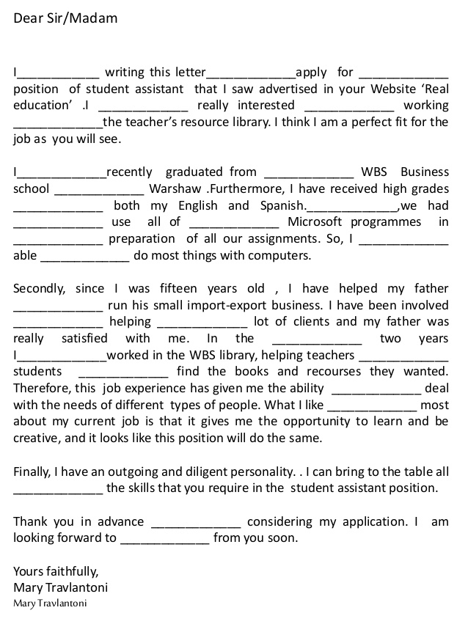
a, am, am, am, to, to, to, to, to, the, the, the, the, the, in, in, in, at, have, for, Moreover, past, of, have, and, for, hearing

Slide 22
Task
Write a letter to a company asking for more information about a job that they had advertised in last week’s newspaper. Inquire about the following details:
Work hours
Salary
Job responsibilities

